Slide 1
Genetic Algorithm Based Path Optimization and Adaptive Routing for Network Overload Avoidance
Ayush Kale
ak2739@njit.edu
NJIT ID: 31573799
Masters in Electrical Engineering

Slide 2
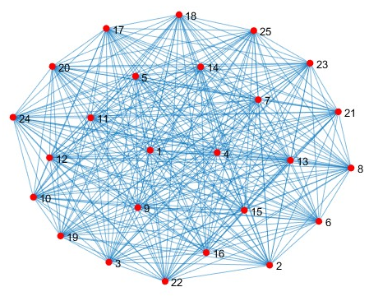
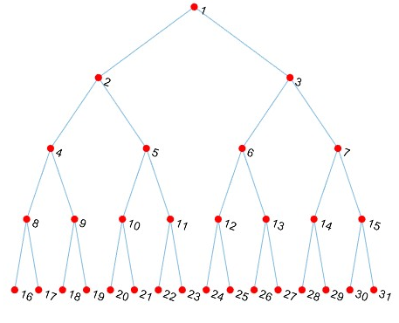
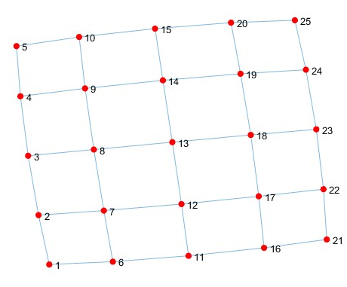
Objective
Design and implement a genetic algorithm-based route optimization algorithm to identify the fastest route between a source host and a destination host in a network with dynamic network link conditions.

Slide 3
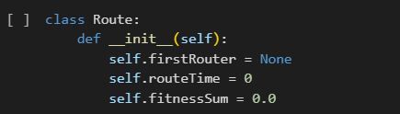
Defined Chromosomes 1
Each ‘route’ object is a chromosome
The chromosome (route) is a linked list of routers (Router Objects).
Each router in the route points to the next router in sequence

Slide 4
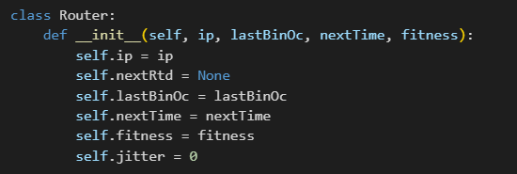
Defined Chromosomes 2
Each ‘router’ object represents a gene in the chromosome.
Each gene includes :
1. IP Address
2. Last Octet
3. Latency to next router
4. jitter
5. Fitness Value

Slide 5
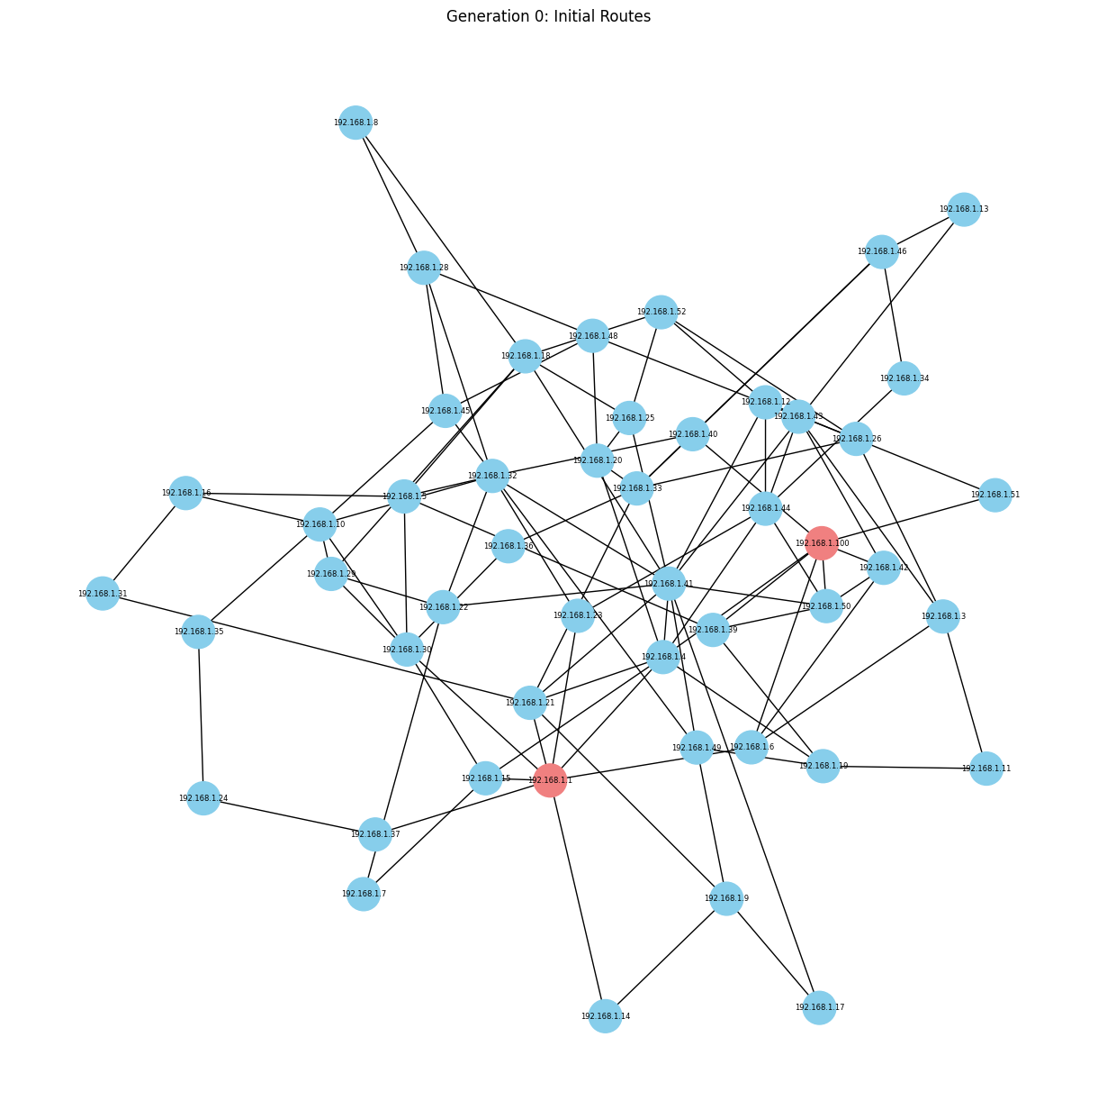
Prior Work
INITIAL NETWORK BEFORE USING GA

Slide 6
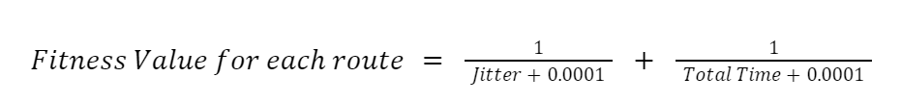

FITNESS FUNCTION
Fitness of a route :
Total Time = Sum of latency in ms
Higher Fitness means:
Lower Latency
Stable Jitter
Shorter total time of route

Slide 7
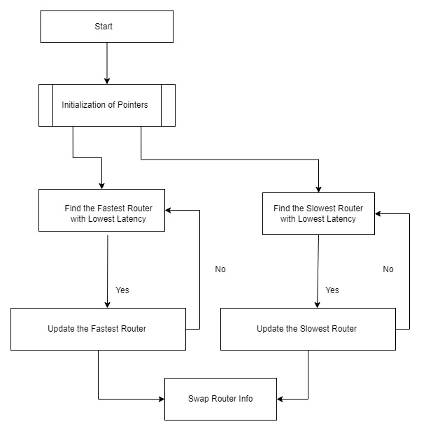
Elitism Function Working

Slide 8
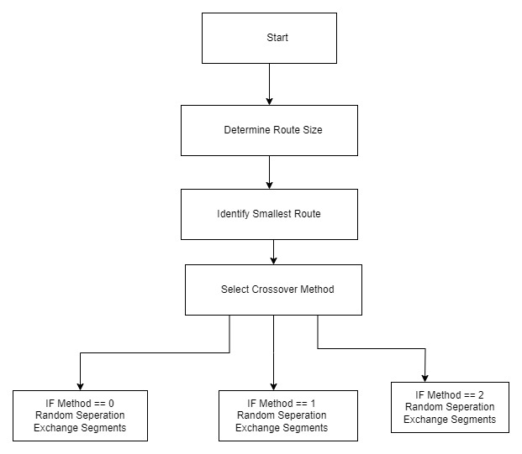
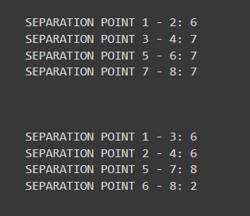
Crossover Working

Slide 9
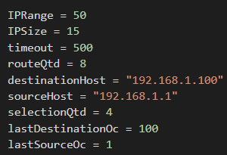
Variables used to initialize Network
IPRange - Range of IP Addresses
IPSize - Subnet Mask
routeQtd - Number of Routes

Slide 10
Other Functions Used
remove_repeated
detect_repeated
mount_route
update_total_latencies
count_routers
evaluate_fitness
collect_generations_history
run_generations

Slide 11
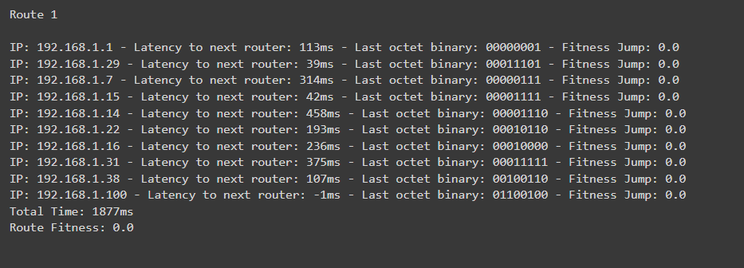
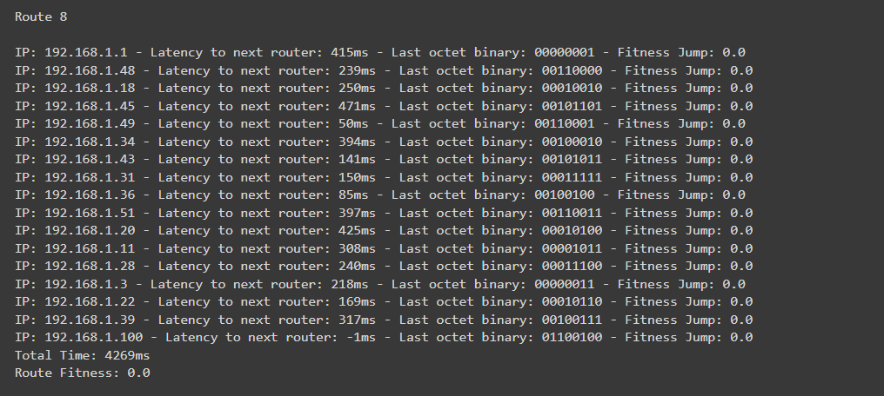
EXAMPLES OF INITIAL ROUTES IN GENERATION 0

Slide 12
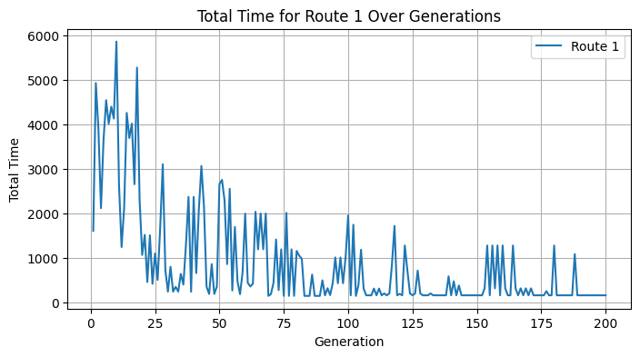
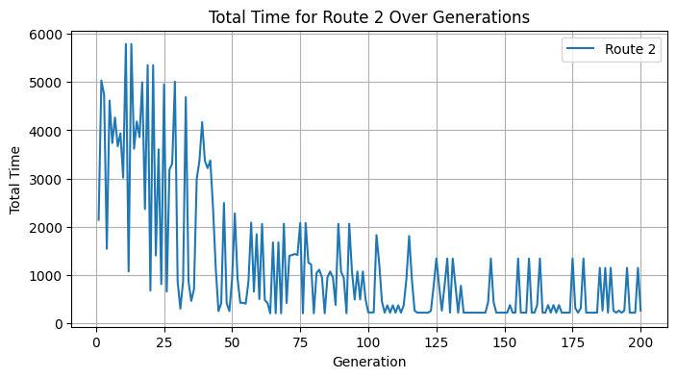
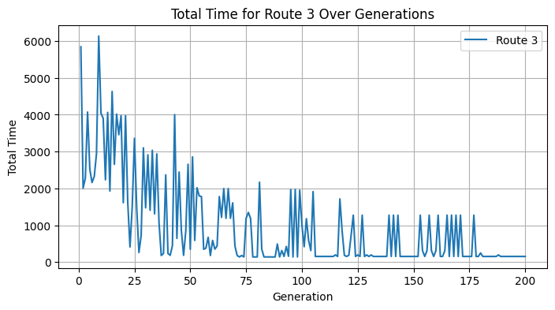
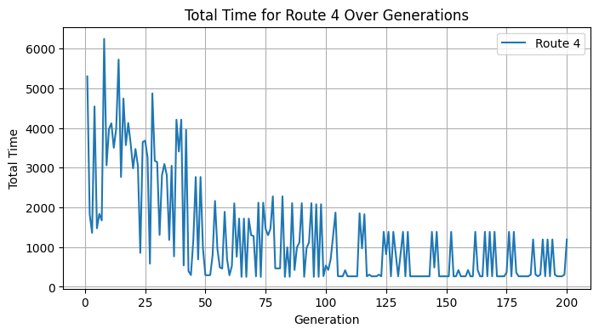
TOTAL TIME TAKEN OVER GENERATIONS FOR EACH ROUTE 1

Slide 13
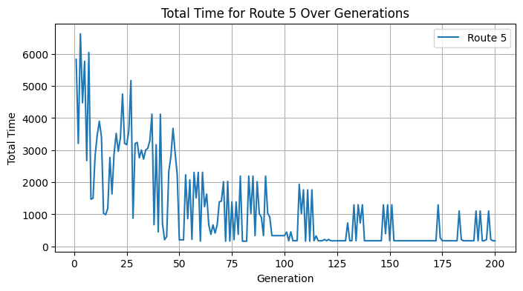
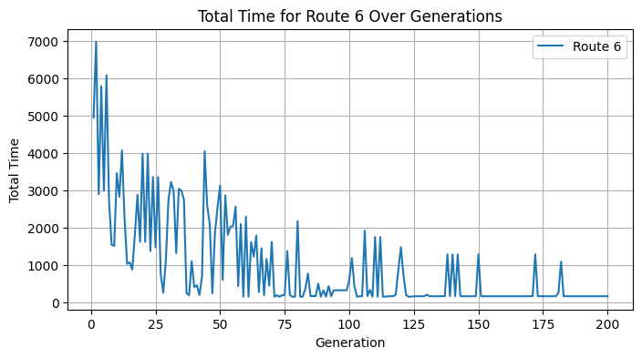
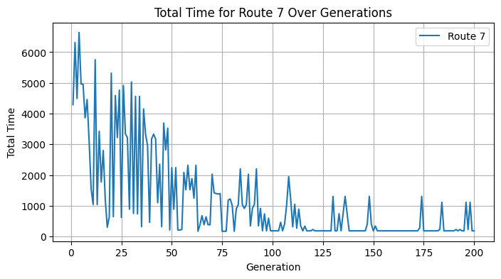
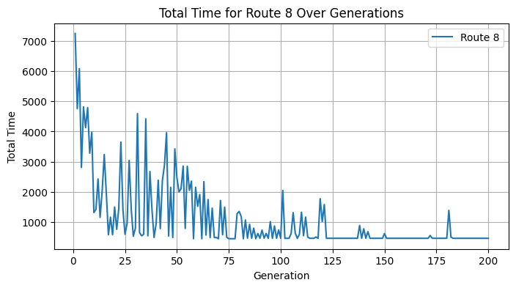
TOTAL TIME TAKEN OVER GENERATIONS FOR EACH ROUTE 2

Slide 14
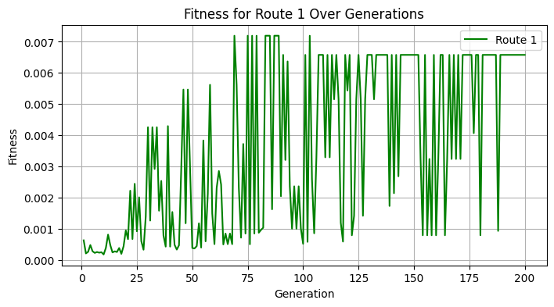
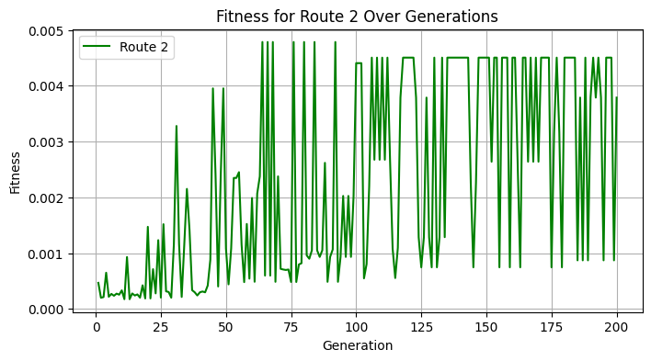
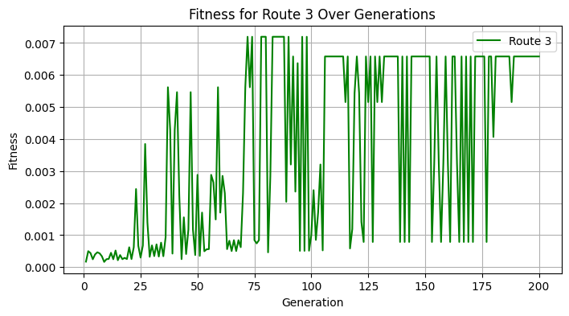
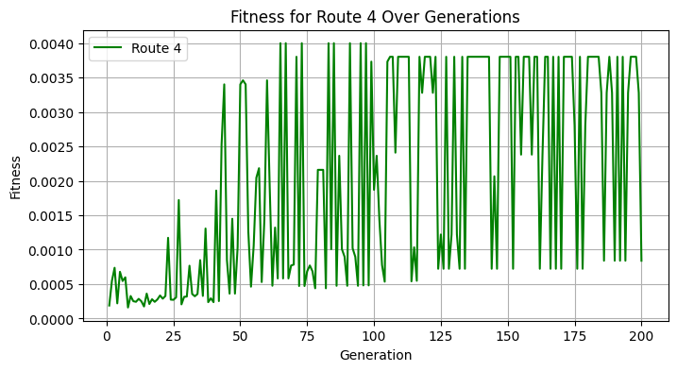
FITNESS VALUES OVER GENERATIONS FOR EACH ROUTE 1

Slide 15
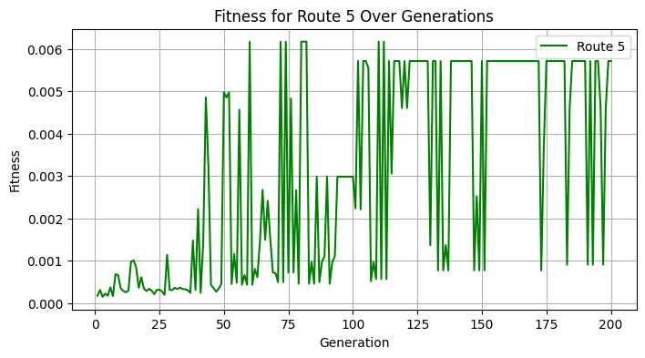
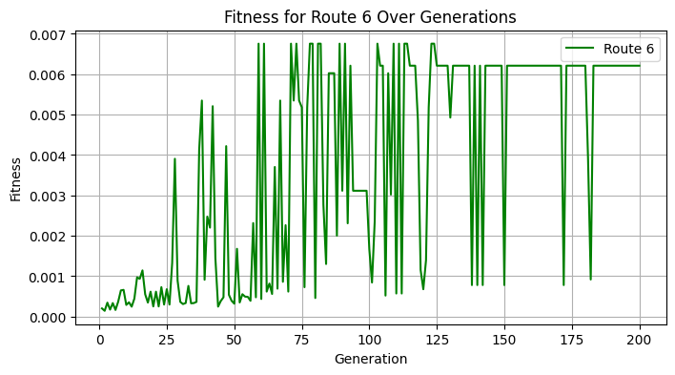
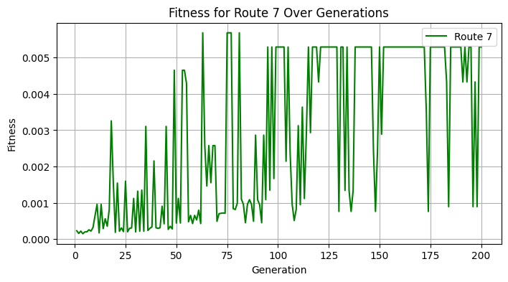
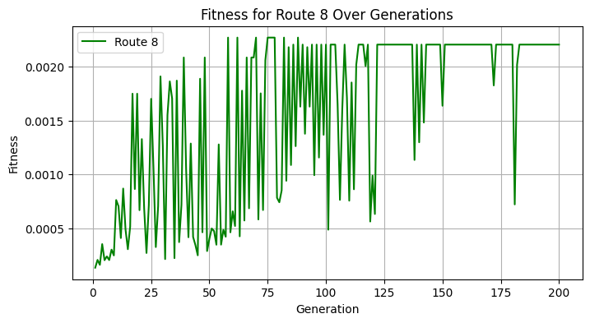
FITNESS VALUES OVER GENERATIONS FOR EACH ROUTE 2

Slide 16
TOP 4 ROUTES USING GA
Route 1: Total Fitness - 0.0008396305555026822
Nodes in Route 1: {'192.168.1.29', '192.168.1.42', '192.168.1.43', '192.168.1.25', '192.168.1.8', '192.168.1.1', '192.168.1.100', '192.168.1.21', '192.168.1.3', '192.168.1.23', '192.168.1.16'}
Route 2: Total Fitness - 0.002202643123289799
Nodes in Route 2: {'192.168.1.29', '192.168.1.100', '192.168.1.1'}
Route 3: Total Fitness - 0.0037878786443985364
Nodes in Route 3: {'192.168.1.29', '192.168.1.15', '192.168.1.100', '192.168.1.1'}
Route 4: Total Fitness - 0.0052910050110579355
Nodes in Route 4: {'192.168.1.29', '192.168.1.100', '192.168.1.1'}

Slide 17
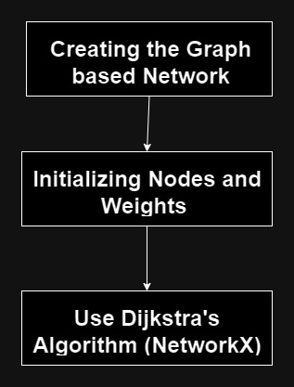
Dijkstra’s Algorithm
Implemented Dijkstra’s Algorithm using the same network used in Genetic Algorithm with Router and Route classes.
Using the fitness values of each router based on Latency and Jitter as cost of the network Link.

Slide 18
Dijkstra’s Algorithm Result
Shortest Path from 192.168.1.1 to 192.168.1.100:
['192.168.1.1', '192.168.1.98', '192.168.1.82', '192.168.1.92', '192.168.1.40', '192.168.1.73', '192.168.1.52', '192.168.1.32', '192.168.1.3', '192.168.1.57', '192.168.1.70', '192.168.1.85', '192.168.1.19', '192.168.1.100']

Slide 19
Comparing GA and Dijkstra’s Algorithm 1
Optimizing for Multiple Objectives:
GA can be used to optimize for multiple objectives simultaneously, such as minimizing time, energy consumption, or load balancing.
Exploration of Solution Space:
GA explores a wide solution space whereas Dijkstra's will converge to a optimum value.
Genetic Algorithms are adaptable to dynamic or changing network conditions.
GA can discover and optimize multiple routes, enabling load balancing across the network.
Helpful in scenarios where distributing traffic or resources across multiple paths is essential for efficiency and reliability.
Dijkstra's algorithm would requires less memory compared to genetic algorithm.

Slide 20
Comparing GA and Dijkstra’s Algorithm 2
Dijkstra's algorithm guarantees an optimal solution for finding the shortest path in a weighted graph. It finds the globally optimal solution in terms of the sum of edge weights.
Dijkstra's algorithm is highly efficient for solving single-objective shortest path problems.
Genetic Algorithms involve randomness in the initialization and evolution processes, leading to different results in different runs.

Slide 21
References
https://github.com/vitorlofonseca/prodalg

Slide 22
THANK YOU !

